Slide 1



PKM Educational Trust ®
R. R. Institute of Technology
Affiliated to VTU Belgaum and Approved by AICTE, New Delhi ,Recognized by Govt. of Karnataka
Accredited by NAAC with ‘B+’
Raja Reddy Layout, Chikkabanavara, Bengaluru – 560 090
DEPARTMENT OF COMPUTER SCIENCE AND ENGINEERING
Internship Report on
PYTHON WITH MACHINE LEARNING
Presented by
KHUSHBU BHANDARI (1RI21CS400)
EXTERNAL GUIDE
Mr. Sunil Kumar
INTERNAL GUIDE
Dr. Manjunath R

Slide 2

TABLE OF CONTENT
Chapter 1 : About The Company
Chapter 2 : Department profile
Chapter 3 : Task Assigned
Chapter 4 : Approach Used
Chapter 5 : Reflection notes
Chapter 6 : Conclusion
Codes
Output

Slide 3
CHAPTER 1
COMPANY PROFILE
Karunadu Technologies Pvt. Ltd. is a leading IT software solutions and services industry focussing on quality standards and customer values. Karunadu Technologies Pvt. Ltd. offer broad range of customized software applications powered by concrete technology and industry expertise.Also offers end to end embedded solutions and services.
Vision
To Empower Unskilled Individual with knowledge, skills and technical competencies in the field of Information Technology and Embedded engineering which assist them to escalate as integrated individuals contributing to company’s and Nation’s growth.

Slide 4
Mission
Provide cost effective and reliable solutions to customers across various latest technologies.
Offer scalable end-to-end application development and management solutions.
Provide cost effective highly scalable products for varied verticals.
Focus on creating sustainable value growth through innovative solutions and unique partnerships.
Create, design and deliver business solutions with high value and innovation by leveraging technology expertise and innovative business models to address long-term business objectives.
Objectives
To develop software and Embedded solutions and services focussing on quality standards and customer values.
Offer end to end embedded solutions which ensure the best customer satisfaction.
To build Skilled and Talented manpower pool for global industry requirements.
To develop software and embedded products which are globally recognized .

Slide 5
CHAPTER 2
DEPARTMENT PROFILE
Karunadu Technologies Pvt. Ltd. offers wide range of technical staffing services to suite the requirements of customer, starting from contract staffing to HR consultancy complimented by flexible models at optimal cost and time. Karunadu Technologies Pvt Limited is working with some of the major IT, ITES & Non-IT companies for providing Consultation & Staffing solutions. All Staffing solutions activities are carried and monitored by technical professionals which help’s greatly in understanding the customer requirements.
Skill development and internship
Thesis consultation
Reveiw paper writing
Publishing
Research proposal

Slide 6
CHAPTER 3
TASK ASSIGNED
HOSPITAL SURVIVAL PREDICTION
Objectives : To predict the different patients categories using logistic regression
Software Used : Anaconda,VSCode
Algorithm Used : Logistic Regression
Dataset Used : Training_data.csv
Data Processing Techniques : Labelling string values using LabelEncoder()

Slide 7
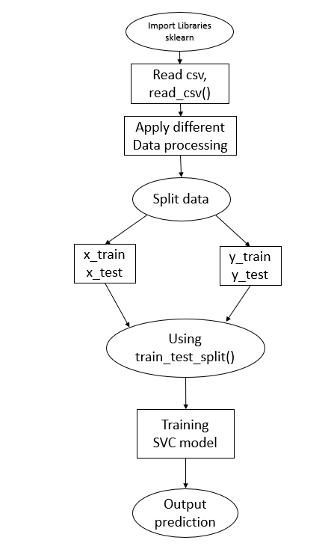
Approach Used:

Slide 8
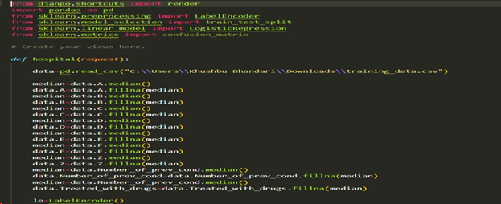
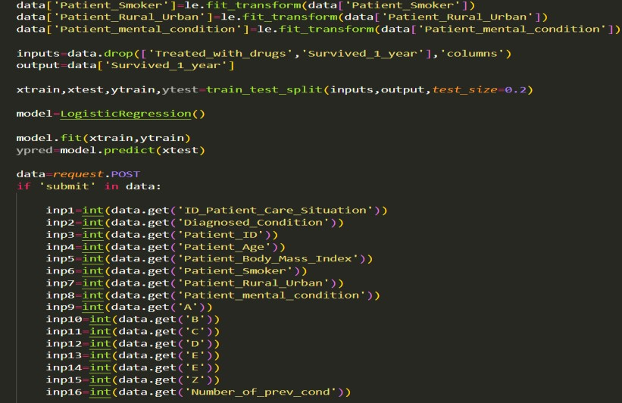
CODE

Slide 9
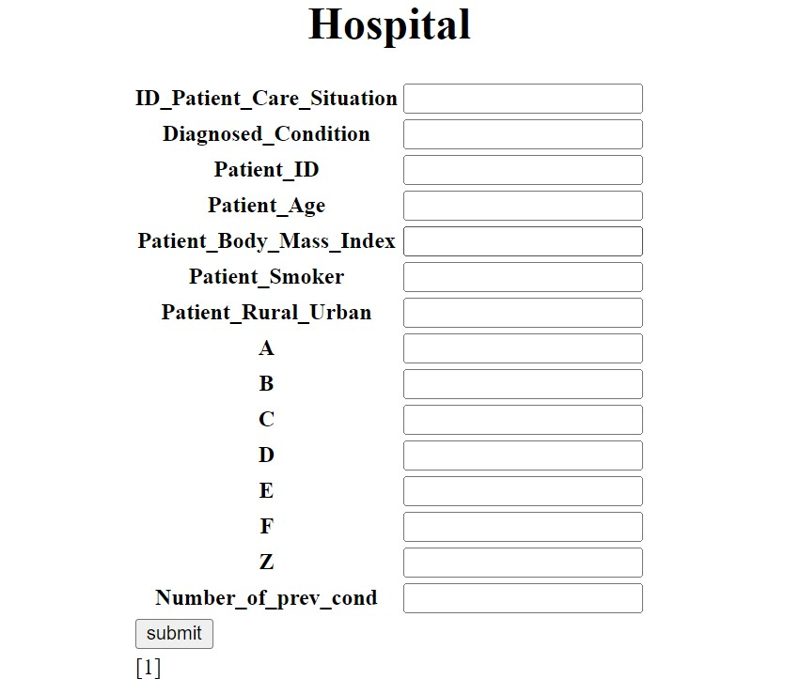
OUTPUT

Slide 10
CHAPTER 4
REFLECTION NOTES
The objective of the internship is to apply theoretical knowledge of “Ai &Machine Learning ” to solve real time complex problems.
The following concepts are learnt during the tenure of the course:
Python
Machine Learning
Data Analysis
Python
Python is a general-purpose, interpreted, high-level programming language.
The topics learnt on Python are as follows:
Use of variables to store, retrieve and calculate information.
Utilization of core programming operations such as functions and loops.
Operation on strings, python supported libraries for Machine Learning. (pandas, matplotlib, sklearn etc.)

Slide 11
Machine Learning
Machine Learning is the field of study that gives computers the capability to learn without being explicitly programmed. Machine learning algorithms use historical data as input to predict new output values.
Types of Machine Learning
Supervised Learning
Classification (SVM, Random Decision, Forests)
Regression (Linear, Logistic)
Unsupervised Learning
Clustering (K-means)
Dimensionally reduction (Principle component, Analysis, SVD)
Reinforcement Learning
Semi-Supervised Machine Learning

Slide 12
CHAPTER 5
CONCLUSION
The internship aims to use Python programming language for Machine Learning so as to apply the theoretical knowledge to solve real-time and complex problems.
The internship helped to find appropriate prediction model to the problems by applying suitable learning algorithm which can be used in future.
After having a basic understanding of Supervised learning, we explored the SVM and Decision Tree which is used to solve machine learning problems.

Slide 13
REFERENCES
www.karunadutechnologies.com
Taiwo Ayodele, “Types of Machine learning algorithms”, 2018
https://www.geeksforgeeks.org/random-forest /
https://www.geeksforgeeks.org/naive-bayes /

Slide 14
THANK YOU

